Slide 1
Information Technology Threats
CIS 480
Brandon Collins

Slide 2
A Longitudinal Study of Information System Threat Categories: The Enduring Problem of Human Error
Ghi Paul Im
Georgia State University
Richard L. Baskerville
Georgia State University

Slide 3
Threat Taxonomy
Baskersville broke them up into 2 major classification
1. Accidental 2.Deliberate
Accidental is broken up into a 2-class one dimensional taxonomy:
1.Catastrophes 2.Errors

Slide 4
Deliberate Threats
caused by the people who interact with information systems and IS development
Broken up into a multiple category, two-dimensional taxonomy: mode and motive
Modes broken up into physical assault, falsification, malicious code, and cracking
The motives of deliberate threats include fraud, espionage, and vandalism
Vandalism-seeking to destroy systems, systems integrity or to deny systems services)
Espionage-seeking to compromise the confidentiality of systems

Slide 5
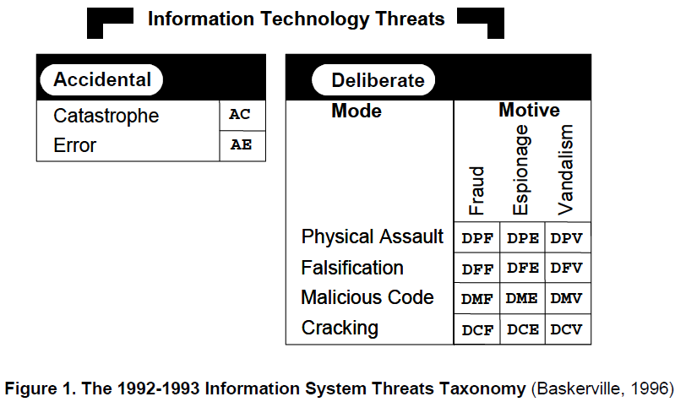
Threat Taxonomy

Slide 6
Taxonomy study
Baskerville sought to demonstrate the validity and usefulness of the taxonomy
analyze the vignettes published in the “Risks to the Public” column by Peter Neumann
two-year period in 1992 and1993
147 distinct incidents of threats

Slide 7
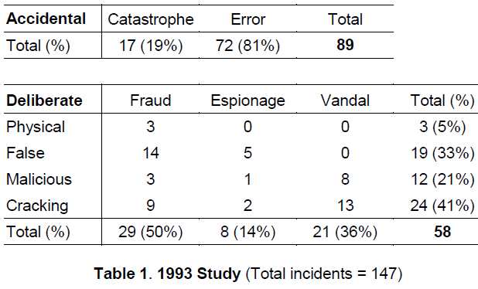

Slide 8
Analysis of Vignettes
four high priority threats for risk management: errors, fraud, cracking, and vandalism
most important threat category was human error
Perhaps fraud has increased, such as identity theft or spoofing.

Slide 9
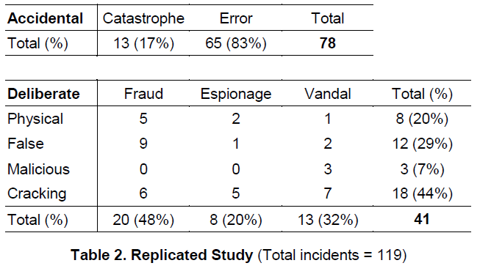
March, 2001through March, 2003

Slide 11
Flaws in study
This original claim is probably too simple
It claims to be useful for modeling threats
Useful and valid in modeling “unmanaged” threats, such as those for which there are no easily available tool-based safeguards
Doesn’t provide any information on what kinds of errors make up this class making it have little practical value.

Slide 12
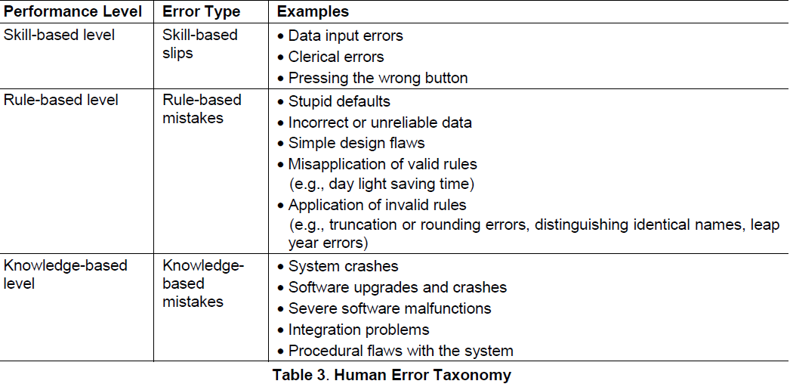
Elaborated Model

Slide 13
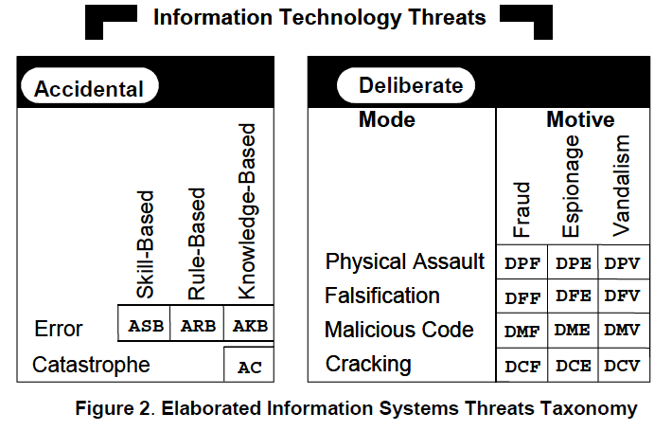
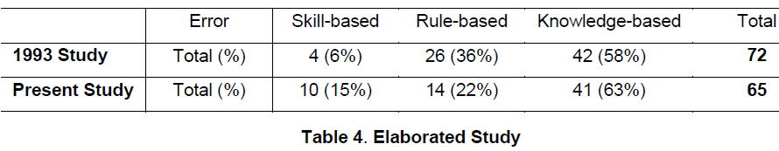

Slide 14
Comparisons
There is an interesting fall in proportion of rule-based errors and rise in the proportion of skill-based errors
a large number of inexperienced, but well-supervised new professionals in the field during the early part of the 2000’s
such conclusions are highly speculative and require further research.

Slide 15
Approaching Human Error
Avoidance:
improving the system interface, providing better security policies and procedures, or providing better training
user-centered security
security policies and procedures
training programs

Slide 16
Tolerance
We can design systems so that they are fault-tolerant with respect to human errors, and thereby minimize the effects of human errors as security threats
Bill Gates has set “trustworthy computing” as the highest priority for his company, which means the computing must be available, reliable and secure as electricity, water services and telephony

